Slide 1



Predicting Student Dropout
Avery Li, Rem Turatbekov

Slide 2
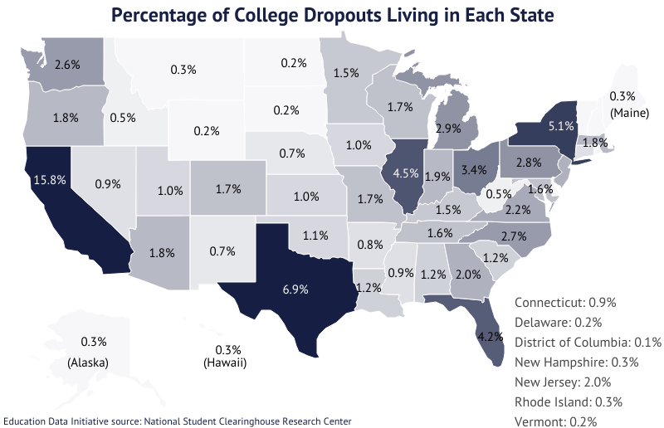
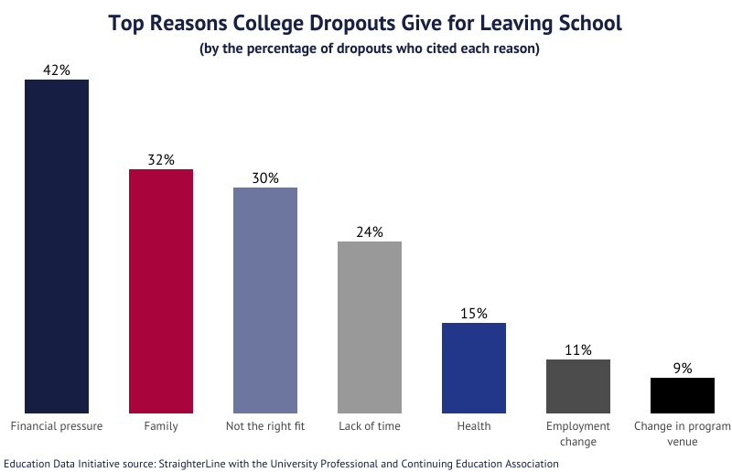
Background
https://educationdata.org/

Slide 3
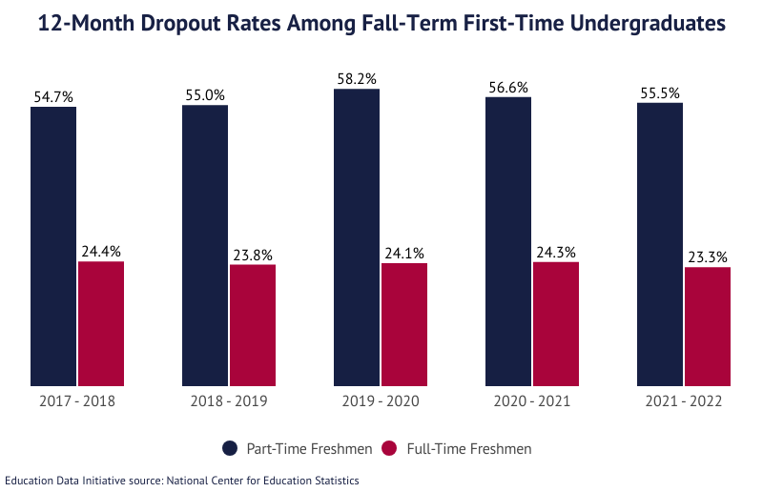
Highlights
First-time full-time undergraduate freshmen have a 12-month dropout rate of 23.3%
41.9 million Americans were college dropouts as of July 2022; 943,169 of them re-enrolled that fall
Dropouts make an average of 35% less income than bachelor’s degree holders
Dropouts are 20% more likely to be unemployed than any degree holder
https://educationdata.org/

Slide 4


Project Introduction
Prevalent dropouts
COVID-19
Oversaturation in workforce
But WHY?
Academic success = success in workforce
Adapt curricula
Notes:
We just saw the high dropout rates, which have only been exacerbated by the COVID pandemic. And as we know today, there’s a widely oversaturated job market, with many students scraping their way through college just to graduate… straight to unemployment. But… why are we predicting student dropout and not fixing other stuff with the economy and the world?
[click] …because thats our machine learning quarter 1 project.
Greater success in education often serves as a differentiator when searching for a job, and by studying the predictive factors for dropping out, we can improve policies and adapt the curriculum to improve student retention. This will hopefully lead to more students staying in school, completing their education, and developing more skills to help them find a job and support their families.

Slide 5

Data Description
UCI Repository - 2021 data
36 attributes - student information and personal background
Nationality, Father’s Occupation, Tuition fees, Grades
Instance = student-situation pair
Uniform distribution of class (“Target”)
Dropout, Graduate, Enrolled
No missing values
How did we preprocessing?

Slide 6
Data Issues
Data delimited by semicolon
Integer to string mapped data
Creates false sense of order for nominal data
Nationality, Marital Status
Derived attributes
“International” = “Non-portuguese”
Normalize quantitative data
Admission grade, Age at enrollment, GDP
Decimal scaling from 0 to 5
Class attribute → binary classification
Weka cross validation
Data okay size

Slide 7

Attribute Selection
We used the following Weka attribute selection models:
CorrelationAttributeEval
InfoGainAttributeEval
GainRatioAttributeEval
OneRAttributeEval
And:
Intuition
Notes:
We’ll talk about each one and briefly explain what it does

Slide 8
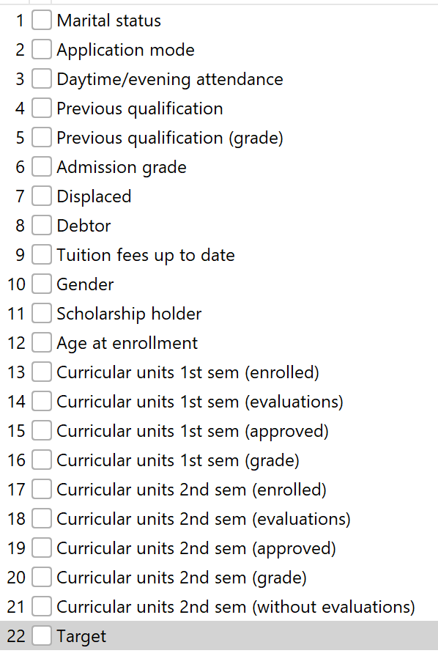
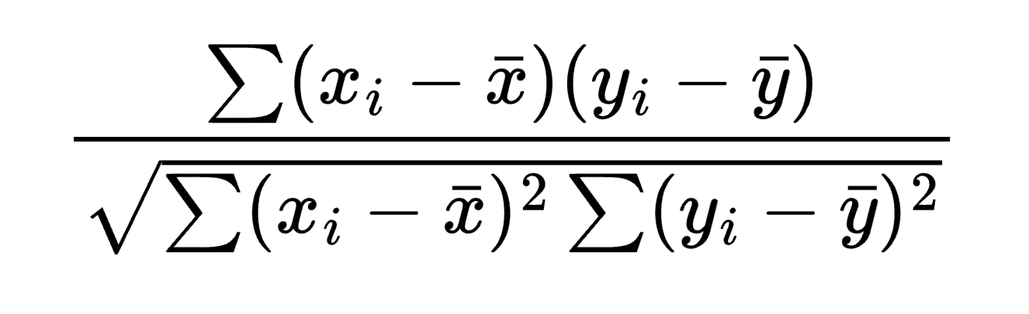
CorrelationAttributeEval
Calculates r-value with the PCC:
Threshold: r > .075
Notes:
Leaves us with 21 attributes

Slide 9
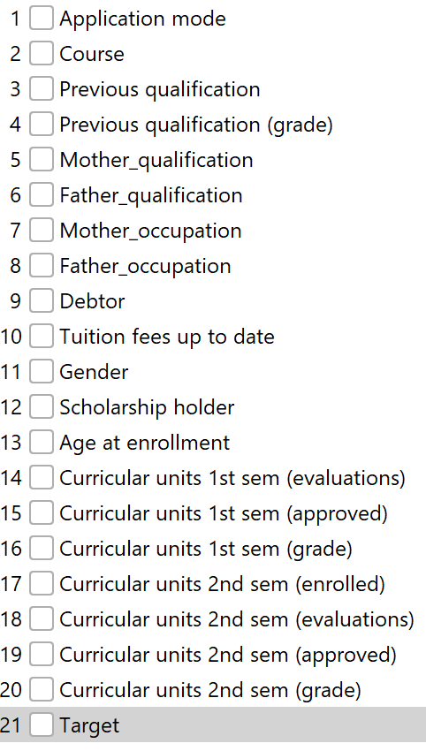
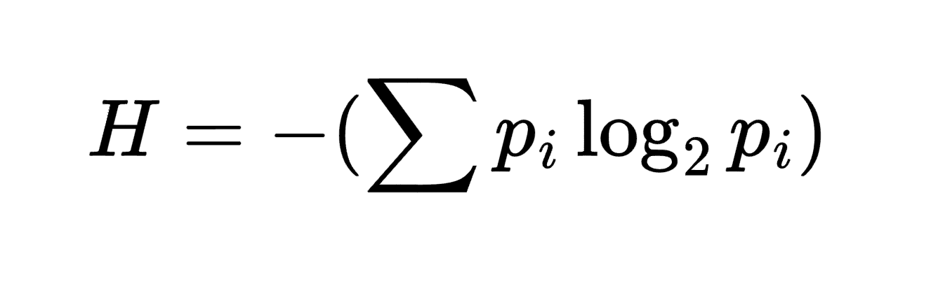
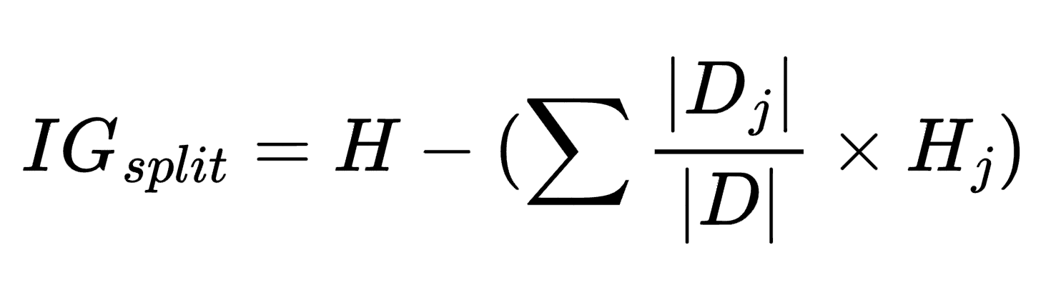
InfoGainAttributeEval
Difference in entropies between output class and the single class decision tree
Threshold: IG_{split} > .025
Notes:
Higher information gain means better predictor
Leaves us with 20 attributes

Slide 10
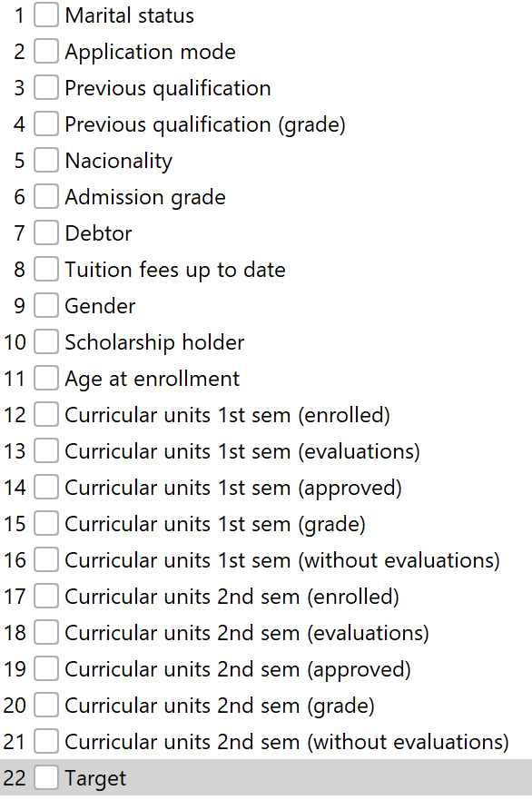
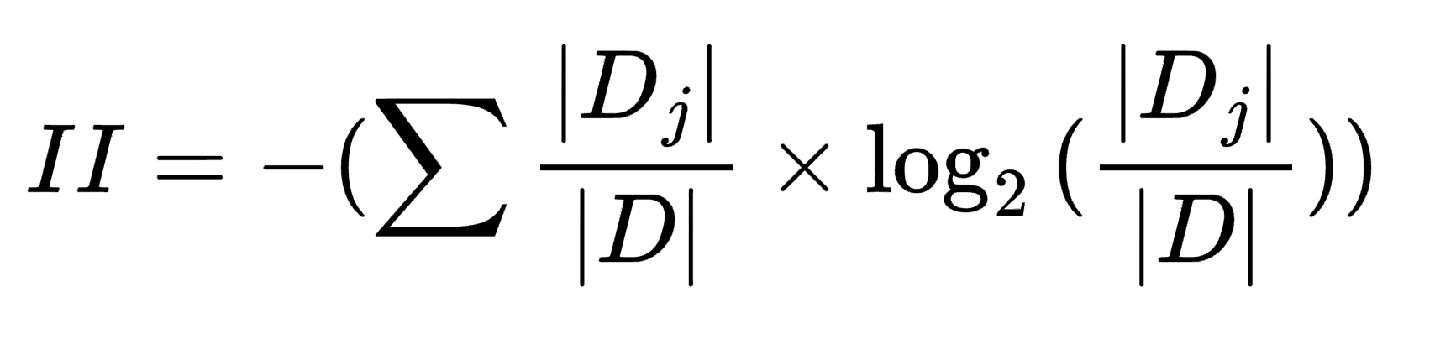
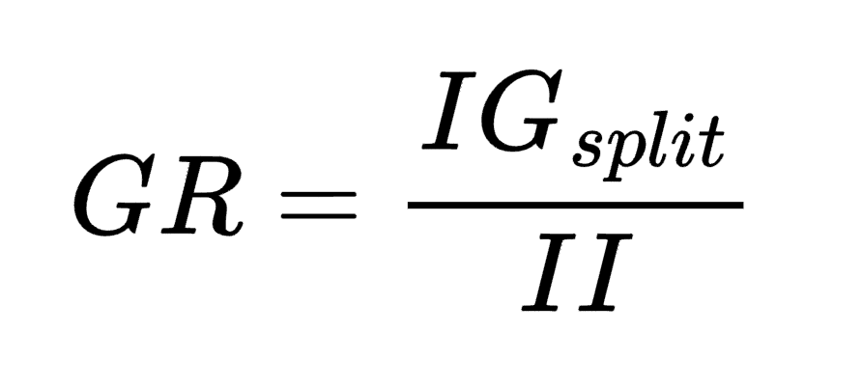
GainRatioAttributeEval
Reduces bias from the information gain metrics.
Intrinsic Information is the entropy of the proportions of the subcategories themselves
Threshold: GR > .14
Notes:
Leaves 21 attributes

Slide 11
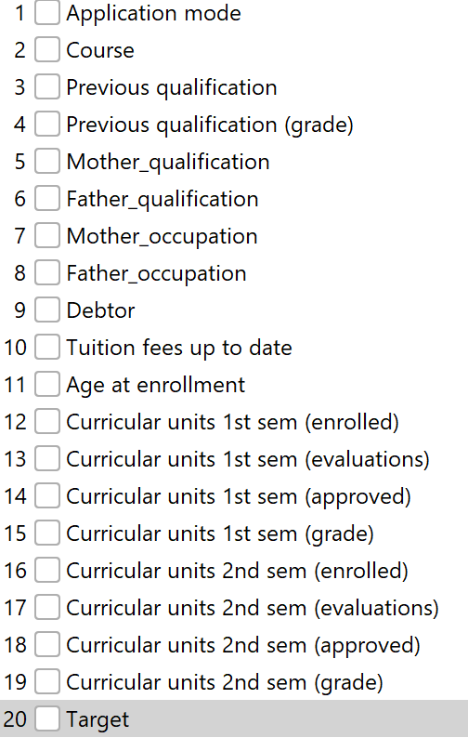
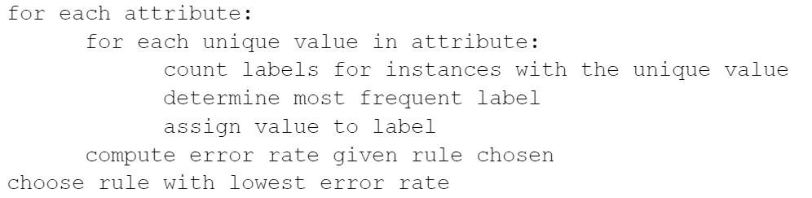
OneRAttributeEval
Evaluates worth of an attribute by a one-to-one ratio of the class labels.
Threshold: worth > 68%
Notes:
Leaves us with 19 attributes

Slide 12
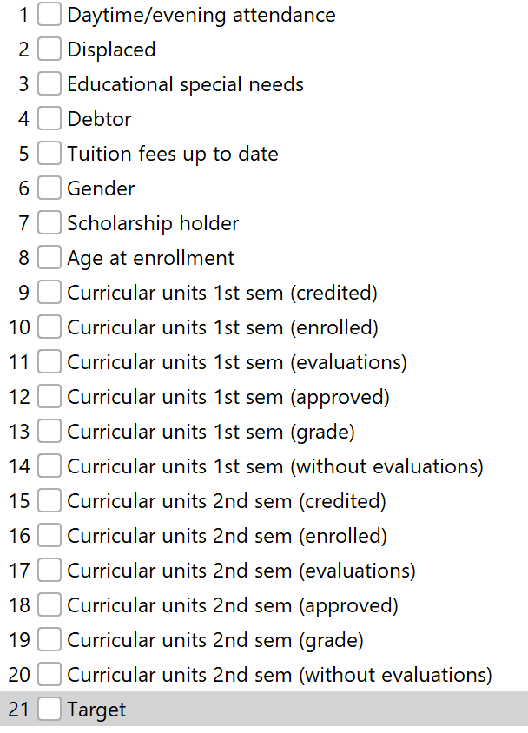
Intuition
People drop multi if they have a bad grade
People drop school if they have bad grades
Other financial and personal factors also important
Special needs, debtor, tuition fee, etc
Notes:
So, intuitively, a student’s grades in the semester is probably the largest driving factor for whether they drop out.
With these selection, we are left with 20 attributes

Slide 13
Classifier Models
J48
Information gain decision tree
NaiveBayes
Probabilistic classifier
Conditionally independent
Logistic
Estimates class probabilities
Maximize log-likelihood
Random Forest
Generates collection of random trees
Evaluates using this “forest”
Notes:
Used Weka’s implementation for all these
Probabilistic classifier, where each feature contributes to the predictions of the output with no relation between each other “conditiionally independent”
…log-likelihood, which measures how well the model predicts the actual outcomes in the training data

Slide 14

Performance Metrics
Accuracy
General performance observation
TP/FP Rate
Better to incorrectly predict a non-dropout student as dropout → TPR
Predict beforehand and intervene if necessary
ROC
Both FPs and FNs are important, so ROC is acceptable

Slide 15

Accuracy
Top 5 models had minimum accuracy of 86.9%
Intuition + Logistic - 87.5%
Correlation + Logistic
InfoGain + Logistic
Intuition + Random Forest
OneR + Logistic
Accuracy largely dependent on classification model used
Notes:
Interestingly enough, it turned out that a model’s accuracy was largely dependent on the type of classification model used, rather than the attribute selection algorithm. Logistic models tended to perform best, followed by Random Forest, J48, and Naive Bayes.

Slide 16

TPR
Achieved minimum TPR of .710
Intuition + Logistic - .875
Intuition + Random Forest
OneR + Logistic
InfoGain + Naive Bayes
Intuition + J48

Slide 17

ROC
Achieved minimum area under ROC of .906
Intuition + Logistic - .914
Intuition + Random Forest
Correlation + Logistic
InfoGain + Random Forest
Correlation + Random Forest

Slide 18
Best Model
Intuition + Logistic
87.5% accuracy
.875 TPR**
.914 ROC
**TPR most important

Slide 19
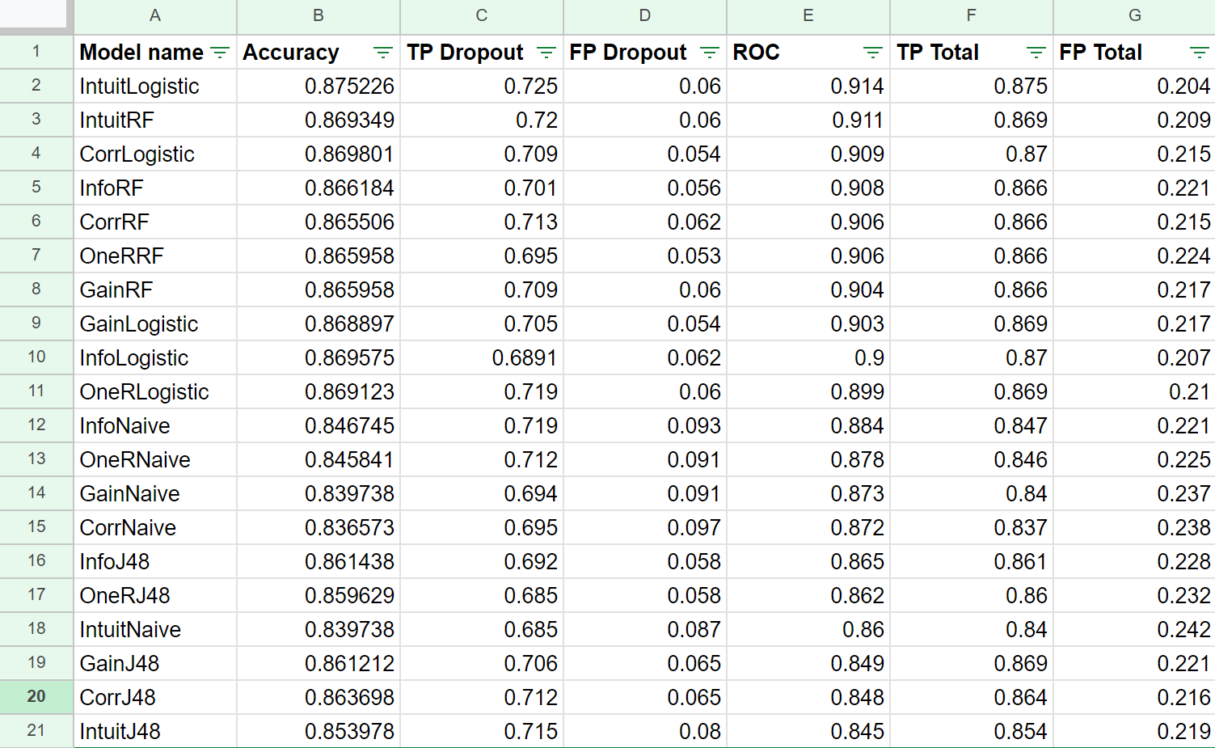

Slide 20
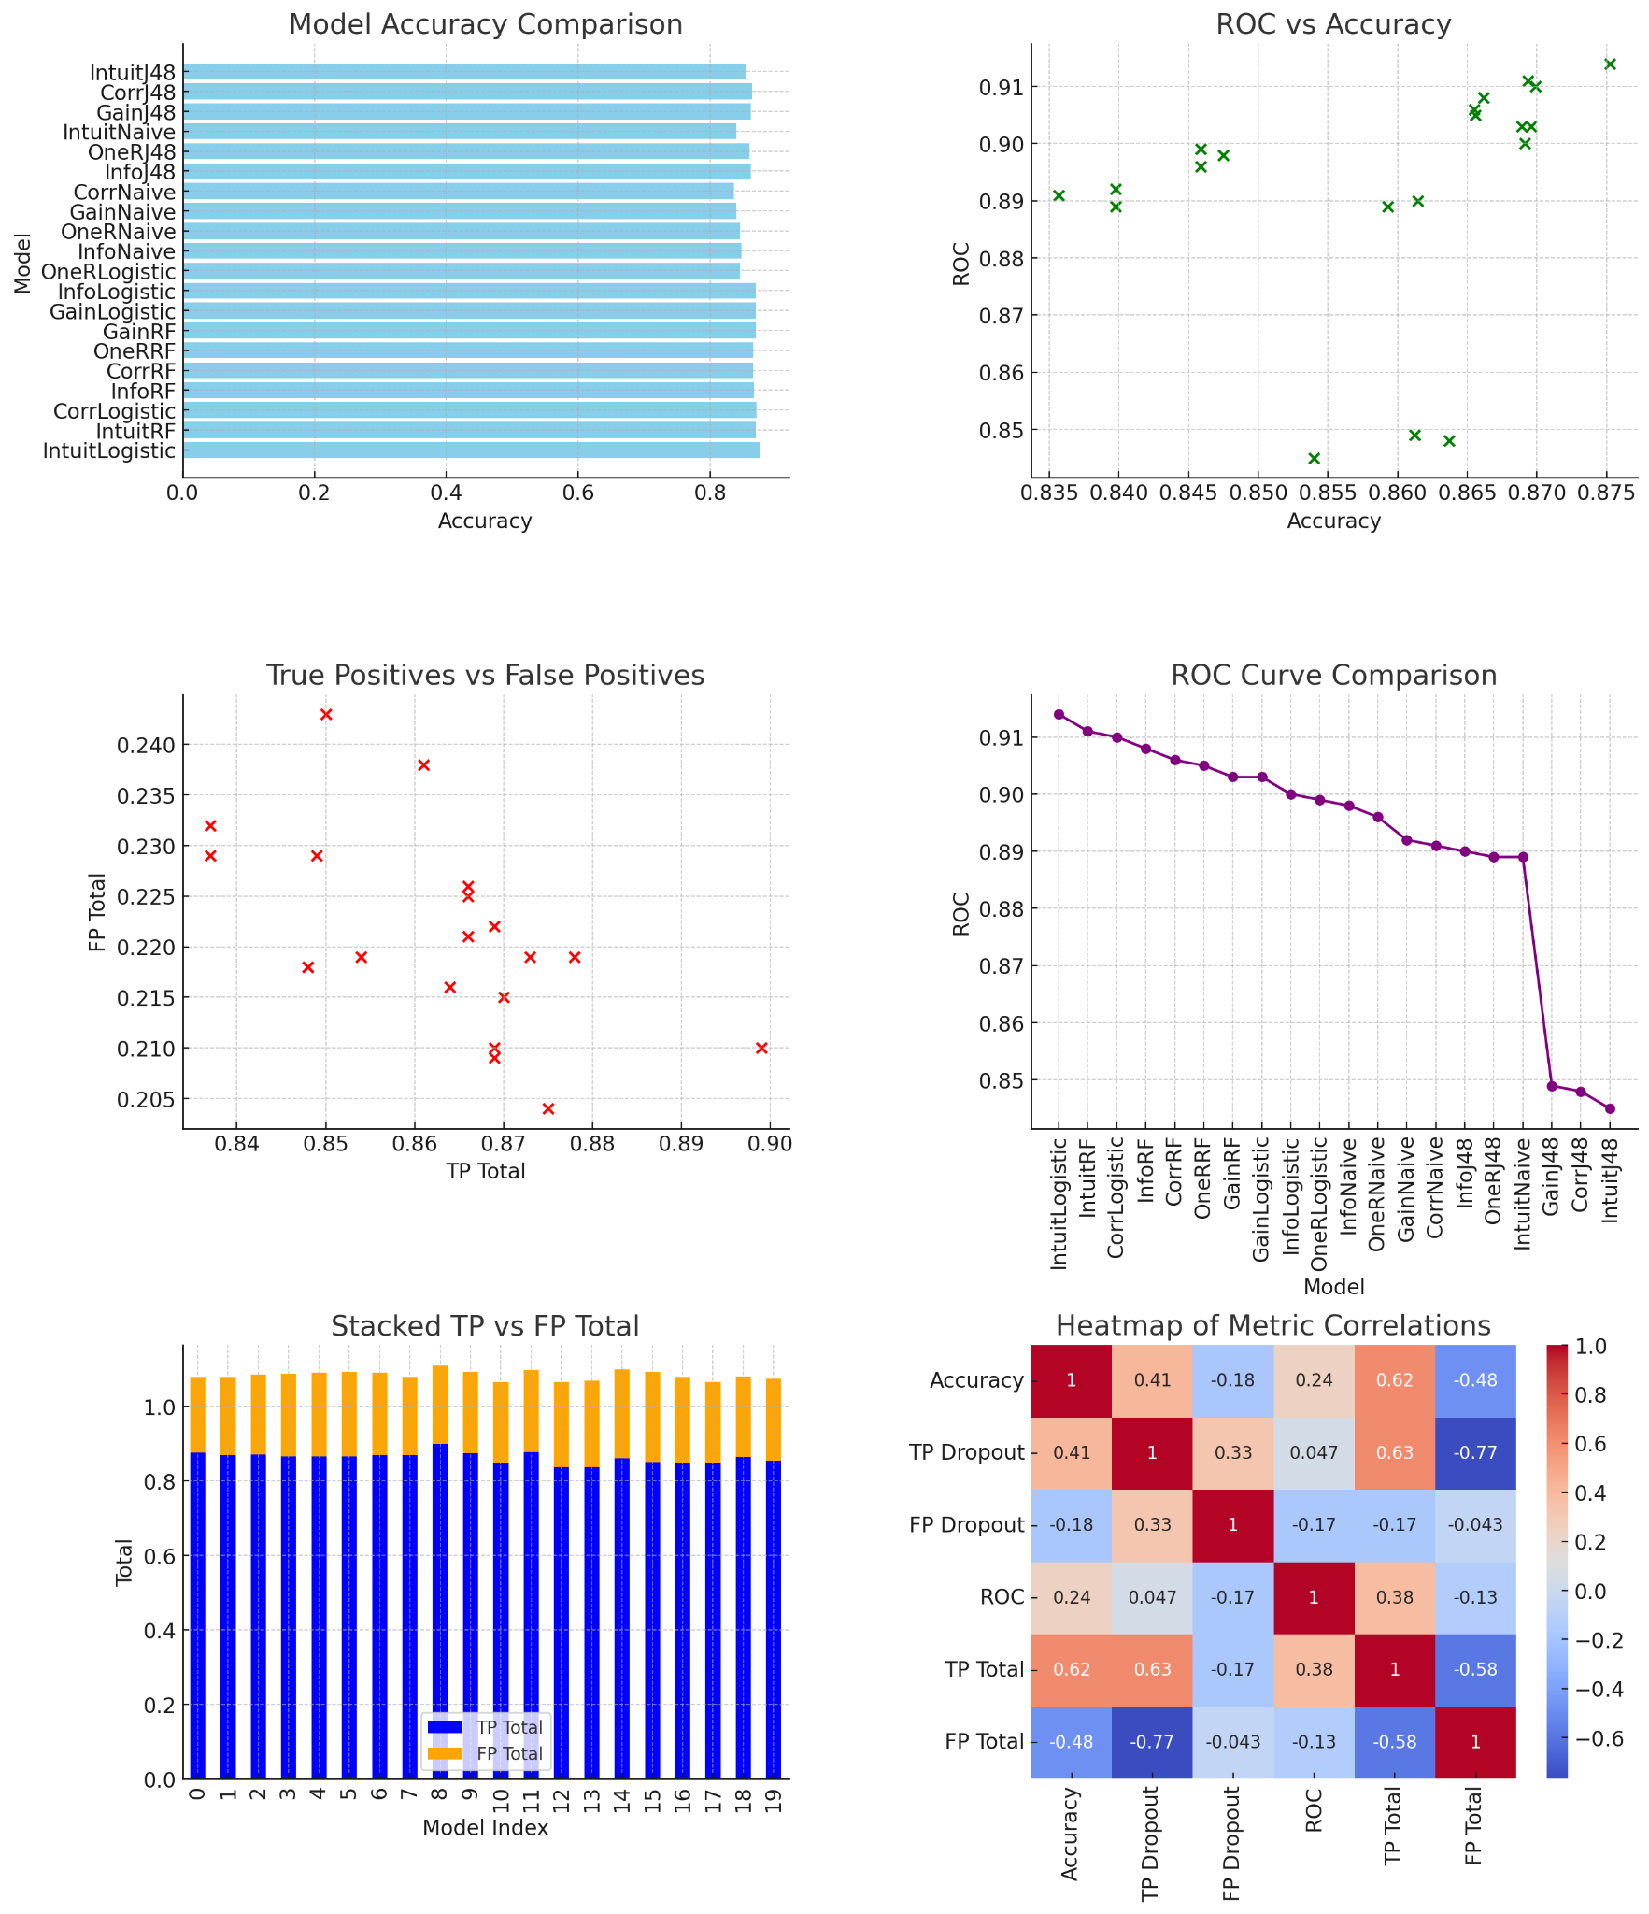
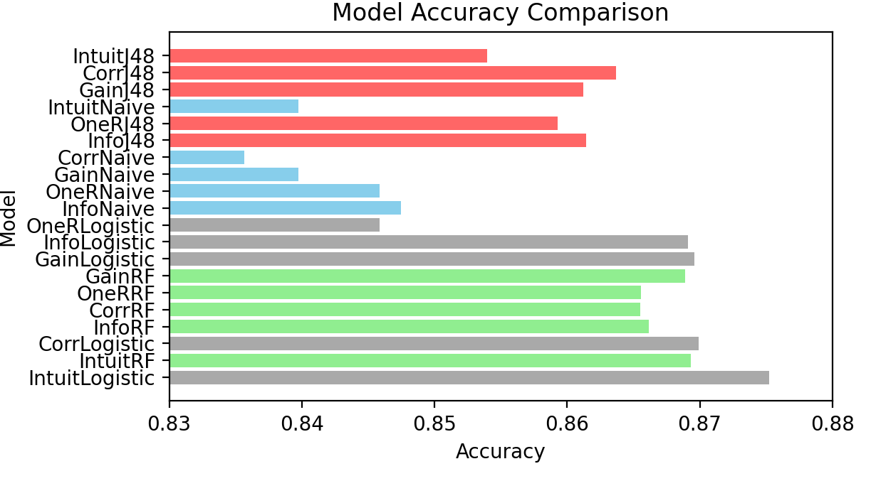




Good accuracy
Low accuracy = low ROC (kinda?)
Stock market crash
Trade-off
Notes:
Accuracy comparison: most around 85%
ROC vs Accuracy: clustered models around .865
accuracy and .905 ROC suggests that small changes in accuracy are not significantly impacting ROC
ROC curve comparison: J48 sucks

Slide 21


TP >>> FP
Accuracy has solid correlation with TP Total
Not too much with ROC
Notes:
Accuracy not correlated with ROC as much as we might’ve expected

Slide 22


Future Research
Intuition + Logistic works best, but something else probably works better
Only used 4 out of 11 available selection algorithms on Weka
Minimum Redundancy Maximum Relevance ??
Recursive Feature Selection ??
Expand data to include more features
Mental health, extracurricular engagement
Longitudinal study to see how the predictive factors change over time

Slide 23

Questions?

Slide 24
References
https://educationdata.org/college-dropout-rates

